Slide 1
API4KP API for Knowledge Bases and Knowledge Platforms
Revised Submission ad//2021-03-01 Response to RFP ad/2010-06-09
Davide Sottara, PhD Principal Knowledge Engineer, Mayo Clinic

Slide 2
Background
Large Scale Knowledge-Driven applications require complex, heterogeneous Knowledge Bases
OWL Ontologies
RDF Graphs w/ SPARQL
UML (Class) Models
BPMN / DMN / CMMN Process Models
PMML Predictive Models
RuleML / RIF / SWRL / CL Rules
GraphQL
APIs, when exist, are proprietary and/or strongly coupled
to Languages (e.g. OWL-APIs)
to Engines/Reasoners (e.g. any commercial BxMS)
to Business Domains (e.g. FHIR in healthcare)

Slide 3
Background
Original RFP addressed (OWL) ontology KBs only
(older versions of) OWL-API and Jena the only options
“micro-API”
Decouple representation from reasoning
Response generalizes the proposal
Add management and delivery dimensions
Supports other kinds of representable knowledge, and languages for the expression thereof
Supports the notion of Composite (heterogeneous) KBs

Slide 4
Revised Submission Group
Various Contributors from multiple Organizations over time
Submitters
88 Solutions
Thematix Partners LLC
Supporters
Arizona State University
Athan Services
Cognitive Medical Systems
Federated Knowledge
Fraunhofer FOKUS / Freie Universitat Berlin / Universitat Leipzig
Mayo Clinic
Micro Focus
Model Driven Solutions
U.S. Department of Commerce (NIST)
Otto von Guericke University of Magdeburg
Raytheon Technologies Company

Slide 5
Submission Scope
APIs for Knowledge Platforms, to be used in the development of Knowledge-based Applications
Semantics of the Operations exposed by means of the APIs
Decomposition of the Operations into simpler Actions
Definition of ‘Knowledge Base’, ‘Knowledge Resource’ and related concepts
Definition of ‘Knowledge Platform’ in terms of the functional roles of its major components
Information Models realizing Descriptions (‘metadata’) of Knowledge Resources minimally viable for Knowledge Management and Delivery
including Vocabularies to designate Knowledge Representation Languages/Notations and related concepts

Slide 6
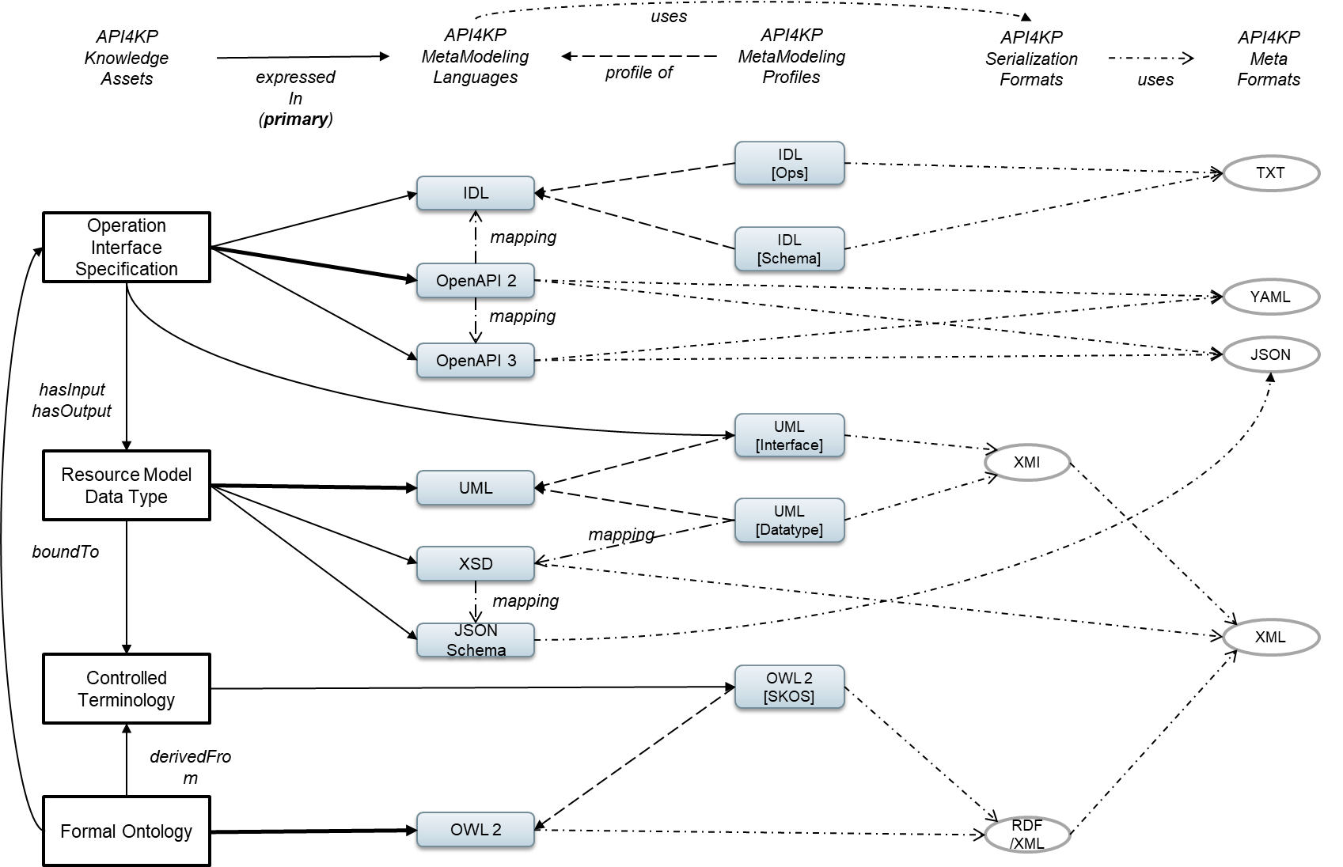
Specification Environment

Slide 7
Specification Artifacts
API4KP Ontologies owl-v2 [DL] + rdf / xml
OWL / SKOS MIREOT
API4KP Terminologies owl-v2 [skos] + rdf / xml
SKOS Compiler
Enums java-v11
SKOS to XSD
Resource Model uml-v2.5 + xmi / xml
XMI to XSD
Resource Schemas xsd + xml
JaxB
POJO Classes java-v11
Swagger to IDL
Resource Schemas xsd + xml
Operations Interfaces IDL-v3
Swagger to IDL
Web API Spec openapi-v2 + yaml
Swagger Codegen
(Web) Service java-v11 [spring]
Swagger to HTML
API Documentation html

Slide 8
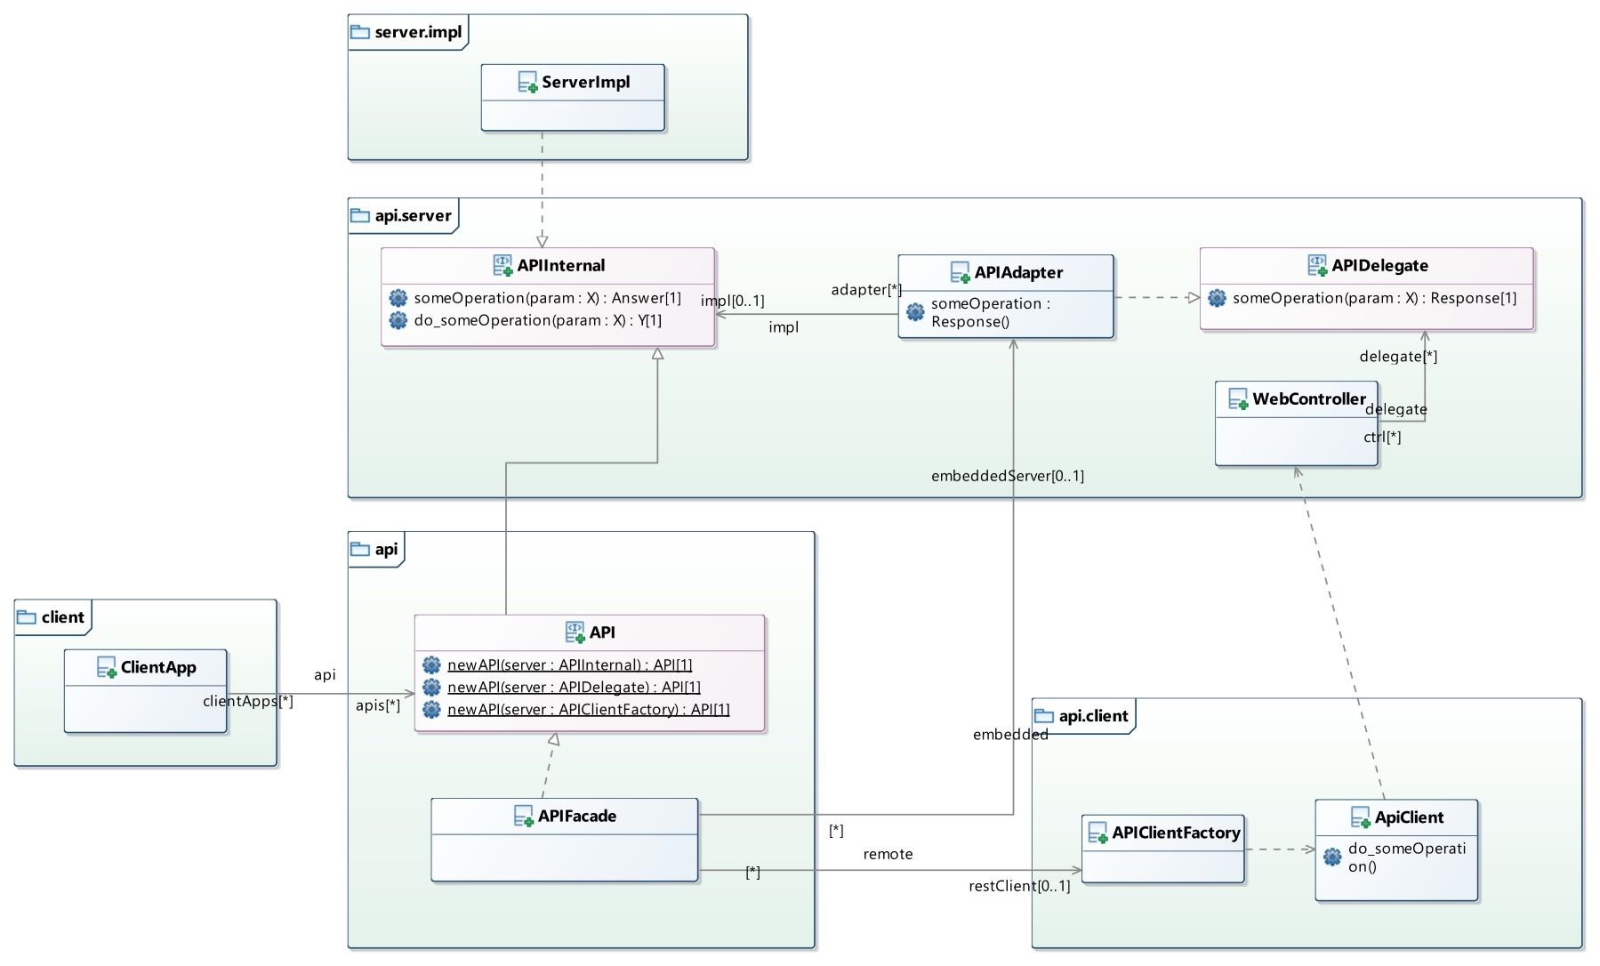
API Integration

Slide 9
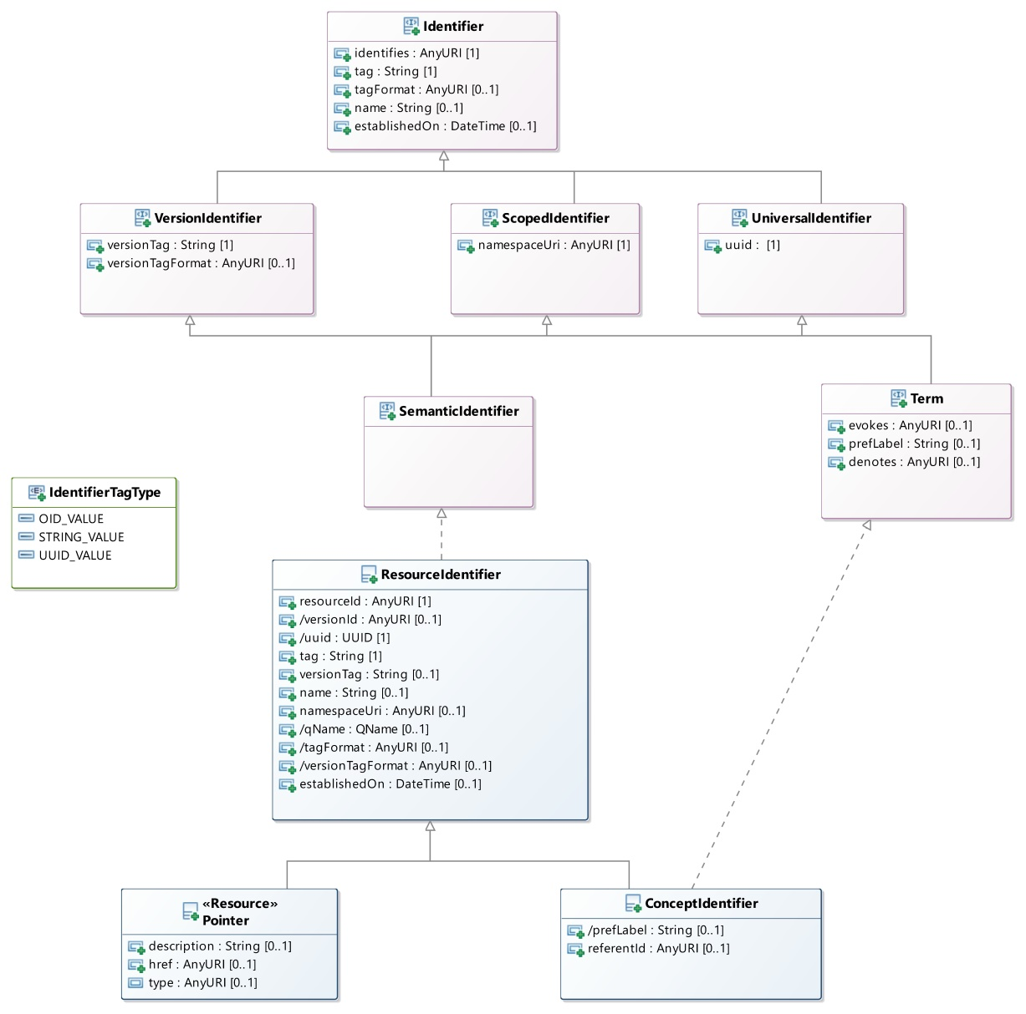
Core Module / Identifiers

Slide 10
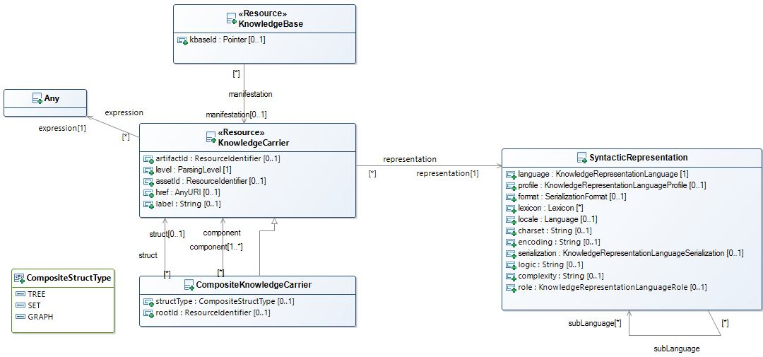
Core Module / “Carriers”

Slide 11
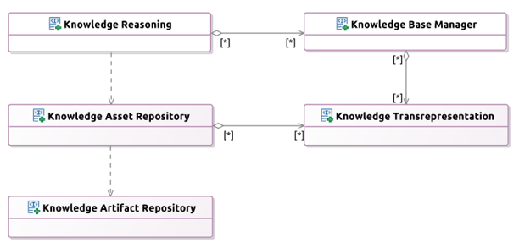
Service Architecture
Modular, Resource-Oriented

Slide 12
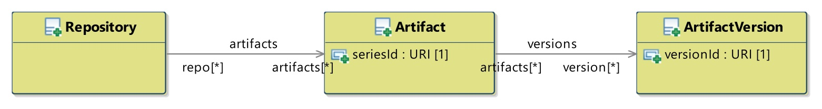
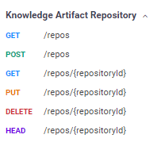
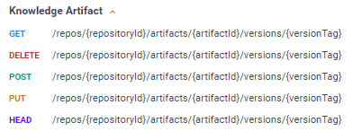
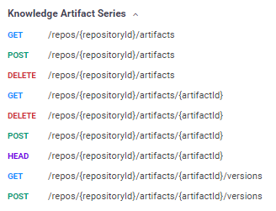
Artifact Repository APIs (KAR)

Slide 13
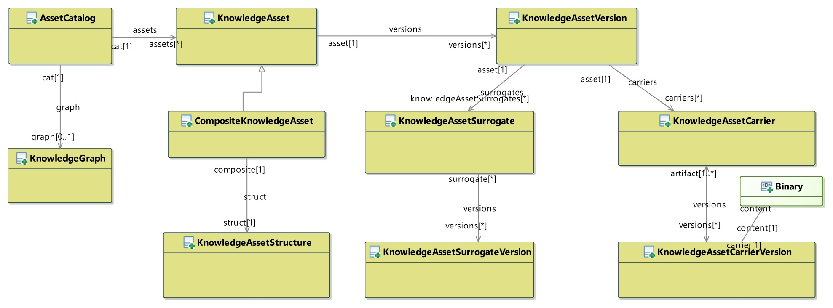
Asset Repository APIs (KASR)

Slide 14
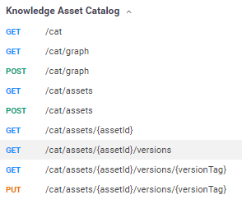
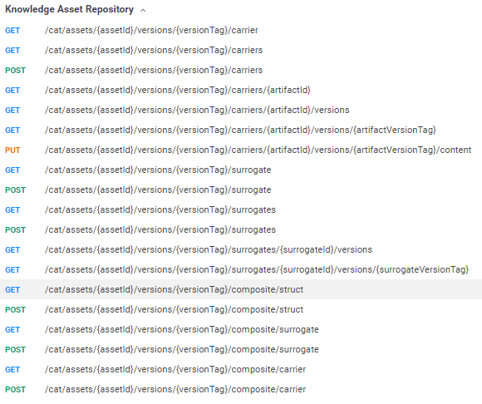
Asset Repository APIs

Slide 15
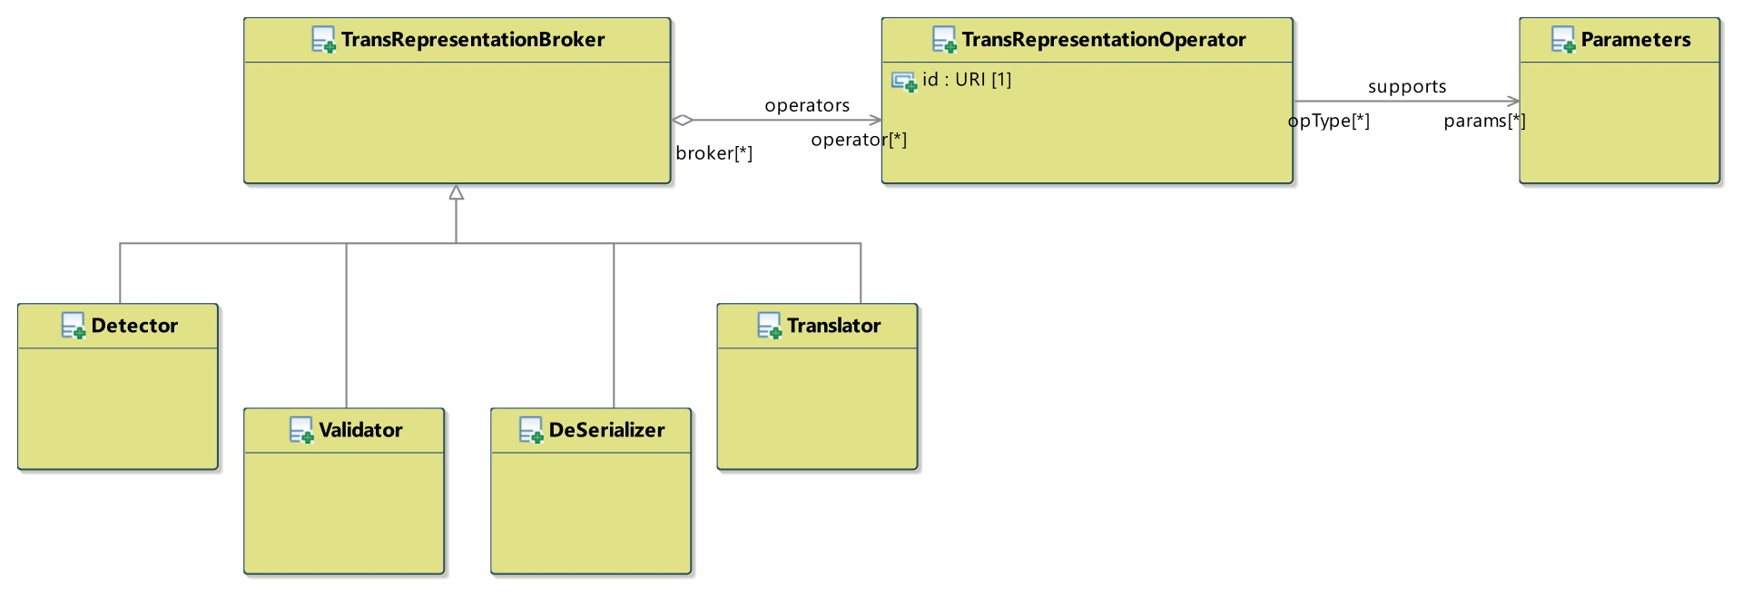
Language T*ion APIs (Tx)

Slide 16
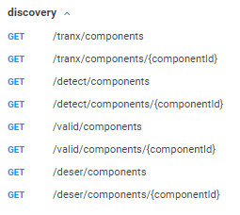
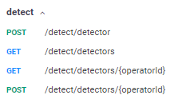
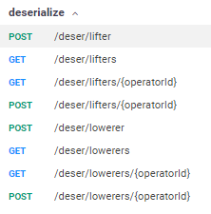
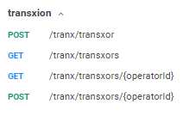
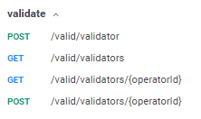
Language T*ion APIs (Tx)

Slide 17
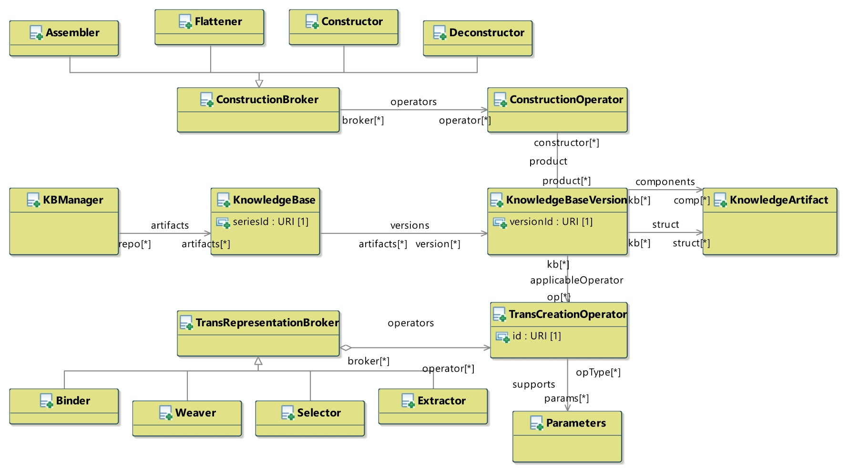
Knowledge Base Manager APIs (KB)

Slide 18
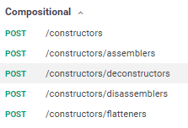
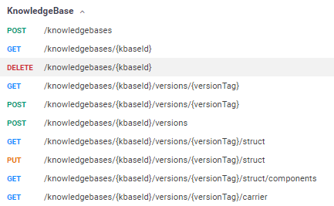
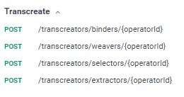
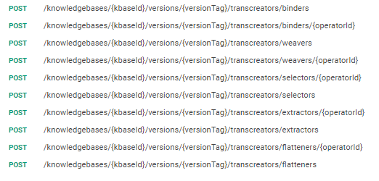
Knowledge Base Manager APIs (KB)

Slide 19
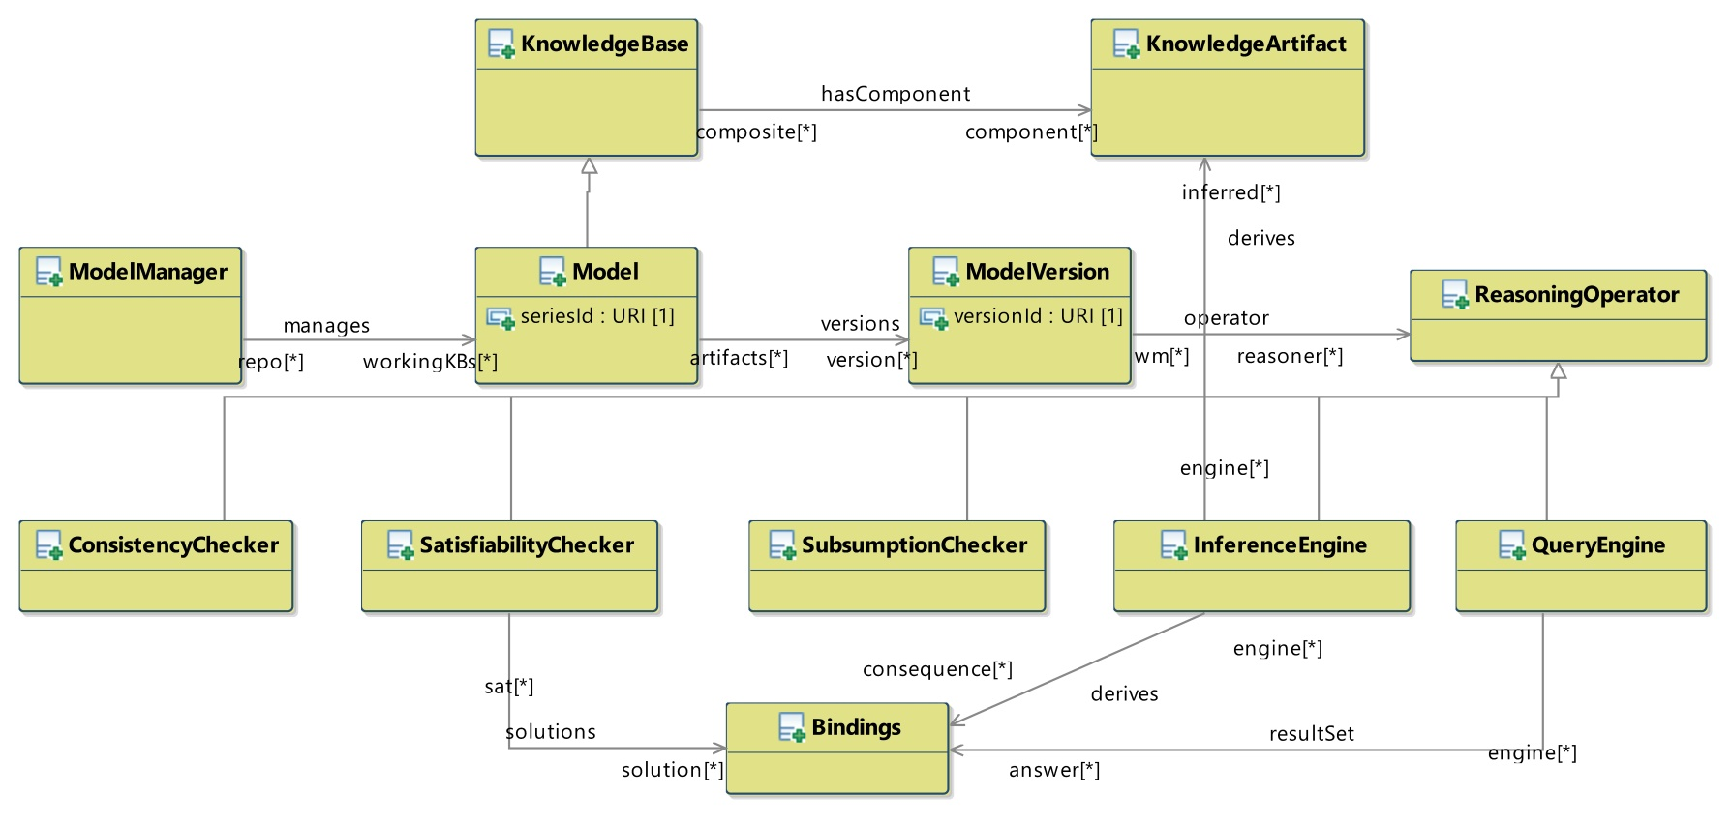
Inference/Reasoning APIs (Inf)

Slide 20
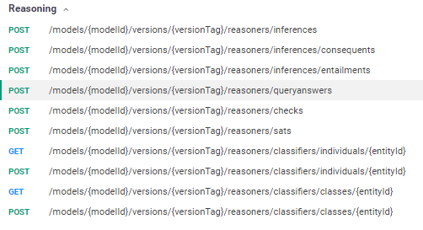
Inference/Reasoning APIs (Inf)

Slide 21
Ontologies

Slide 22
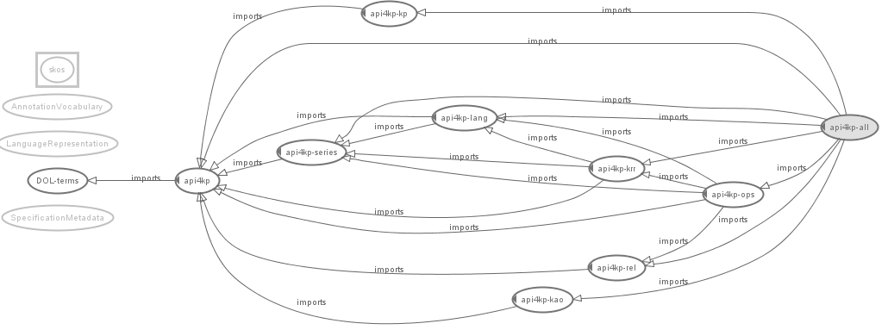
Ontologies

Slide 23
Maturity Model
Status
Not Supported : Unable to support (without major architectural changes
Not Started : On the Roadmap
Draft : Initial Definition exists
Supported : Defined, ready for implementation
In Progress : Partial implementation exists
Implemented : 1+ example implementations finalized
Published : Stable and ready for adoption

Slide 24
Requirements
Requirements – Reference Model | Status
PIM model expressed in UML / MOF | Implemented
UML Model – Platform Architecture | Implemented
IDL Model – Operations specification | Implemented*
OWL Model – Underlying Ontology | Implemented
Most Supported+ features are nevertheless incomplete and subject to evolution

Slide 25
Requirements
Requirements – KB Interrogation | Status
List Ontologies in a KB (→ Separation / Extract of “Resources” in KB API) | Implemented
List Entities: Classes, Relationships, Datatypes and Individuals in a KB (→ Selection of “Resource Fragments” in KB API) | Implemented
List Entities logically related to an Entity: Sub-, Super-, Equivalent (→ Selection of “Resource Fragments” in KB API) | Implemented
Resolve URIs of Entities to Representations thereof, and vice-versa (→ Query / Selection of “Resouce Fragments” in KB API) (→ De-referencing w/ content negotiation in KASR API) | Implemented Implemented
Test the (structural) Equivalence of two Entities given their representation (→ Parse + Diff of “Resources” in KB API ) | Implemented
Most Supported+ features are nevertheless incomplete and subject to evolution

Slide 26
Requirements
Requirements – Knowledge Resource Modification | Status
Construct an Entity (Class, Rel., Individual, ...) in an Ontology (→ Formulate “Resource (Fragment)” + Merge in KB API) | Supported
Delete an Entity (Class, Rel., Individual, ...) in an Ontology (→ Separate “Resource (Fragment)” in KB API) | Supported
Modification of an Entity (Class, Rel., Individual, ...) in an Ontology (Formulate + Filter with Versioning in KB API) | Supported
Most Supported+ features are nevertheless incomplete and subject to evolution

Slide 27
Requirements
Requirements – KP Inference | Status
Check the Consistency of a KB (→ Check Consistency in Inf API) | Supported
Check the Satisfiability of a KB (→ Check Satisfiability in Inf API) | Supported
Test the (mutual) entailment / equivalence between two KBs (→ Check Entailment in Inf API) | Supported
Test the (mutual) subsumption between two Expressions Retrieve all the subsuming/ed Entities given an Expression (→ Check Subsumption in Inf API) | Supported
Test for Class membership of an Individual Retrieve all the Classes an Individual is member of Retrieve all members of a Class (→ Check Memberhsip in Inf API) | Supported
Answer (conjunctive) Queries (→ Query in Inf API ) | Implemented
Most Supported+ features are nevertheless incomplete and subject to evolution

Slide 28
Requirements
Requirements – KB Manipulation | Status
Load an OWL Ontology or a RDF Graph in a KB) (→ Add Resource to KB in KB API ) | Implemented
Unload Ontology from KB (→ Remove Resource from KB in KB API ) | In Progress
Export and Serialized Ontology (→ Lift/Lower Operations in Tx API) | Implemented
Most Supported+ features are nevertheless incomplete and subject to evolution

Slide 29
Requirements
Requirements – PSM | Status
Bind PIM to JAVA | Implemented
Bind PIM to WSDL | Supported (via IDL)
Bind PIM to REST | Implemented
Support PSM Serializations / Implementations | Implemented
Bind PIM to “Lambdas” | Not Started
Bind PIM to CORBA | Draft
Most Supported+ features are nevertheless incomplete and subject to evolution

Slide 30
Additional Features
Supported Capabilities | Status
Identification and Versioning (→ All operations) | Implemented
Composite Knowledge Resources (→ Construct, Assemble, Flatten in KB API) (→ Tx and KASR API map natively ) | Implemented
Operator Negotiation (→ apply vs namedApply) | Implemented
Discover / Describe Knowledge Resources w/ metadata (→ KASR API) | Implemented
Content Negotiation (→ getCarrier in KASR API) | Implemented
Syntactic Manipulation (→ ‘Horizontal’ operations in Tx API) | Implemented
Most Supported+ features are nevertheless incomplete and subject to evolution

Slide 31
Summary
API Status | Status
Knowledge Artifact Repository | Implemented
Knowledge Asset Repository | Implemented
Transrepresentation | Implemented
KnowledgeBase Construction | Implemented
Inference / Reasoning | In Progress
Most Supported+ features are nevertheless incomplete and subject to evolution

Slide 32
Roadmap
Future Capabilities | Status
Stateful Reasoning (→ Inf API) | Roadmap
Error Handling | Draft
Explanations / Proofs | Draft
OpenAPI 3.0 | Supported*
Most Supported+ features are nevertheless incomplete and subject to evolution

Slide 33
Example Implementation
Provided by Mayo Clinic
Clinical Domain Focus
Environment with
15+ Asset Types
15+ Standard OMS Languages
10+ Local OMS Languages
Open Source Implementation (ASL2)
https://github.com/API4KBs/api4kbs

Slide 34
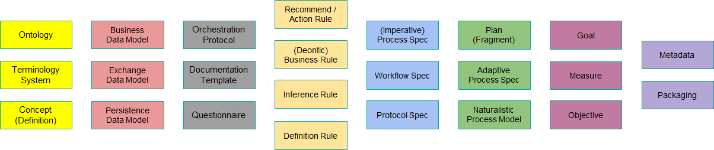
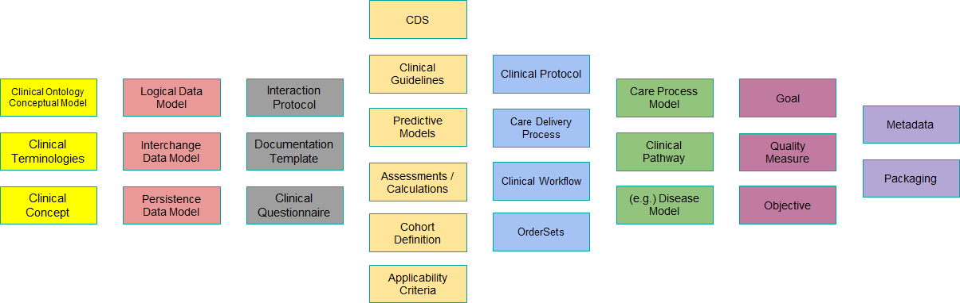
Knowledge Asset Types
Formal
Domain Specific

Slide 35
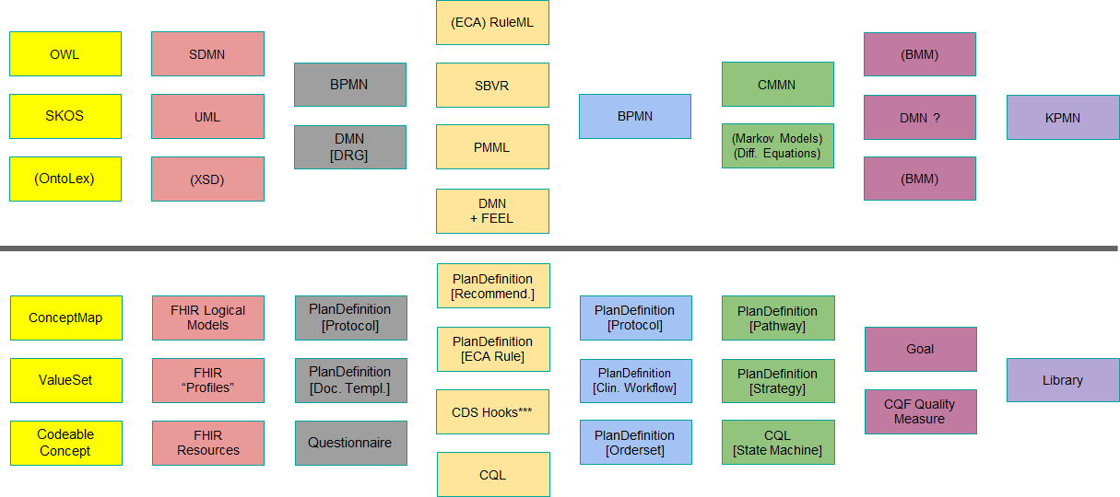
OMS Languages
General Purpose
Domain Specific

Slide 36
Example / Parsing
KnowledgeCarrier<OWLOntology> ontology =
parser.applyLift(
of( “<rdf:RDF><owl:Ontology rdf:about="http://foo"/></rdf:RDF>” )
.withRepresentation(
OWL_2, RDF_XML_Syntax, XML, defaultCharset())),
Abstract_Knowledge_Expression)
KnowledgeCarrier<String> serialized =
ontology.flatMap(owl ->
parser.applyLower(
owl, Serialized_Knowledge_Expression, rep(OWL_2, TTL_Syntax, TXT, defaultCharset()))
API compatible with any Representation that is registered in the Environment

Slide 37
Example / Introspection
KnowledgeCarrier artifact = /* read + lift … */
KnowledgeCarrier manifest = /* read + lift … */
KnowledgeBaseApi kb = KnowledgeBaseAPI.newInstance( /* server */);
KnowledgeCarrier<KnowledgeAsset> surrogate =
kb.initKnowledgeBase(artifact)
.flatMap(p ->
kb.populateKnowledgeBase(
p.getUuid(),p.getVersionTag(), manifest))
.flatMap(p ->
kb.introspect(p.getUuid(), p.getVersionTag()));
Derive canonical ‘Surrogate’ from an Artifact and / or some (parsable) metadata Artifact. The canonical Surrogate can be further translated into other representations.

Slide 38
Example / Publication
KnowledgeCarrier<KnowledgeAsset> surrogate = /* … */
KnowledgeCarrier<OWLOntology> artifact = /* … */
KnowledgeCarrier<byte[]> binary = parser.applyLower(artifact, … );
surrogate.flatmap( meta ->
assetRepo.setKnowledgeAssetVersion(
meta.assetId.uuid, meta.assetId,versionTag, meta);
binary.flatmap( bytes ->
surrogate.flatMap( meta ->
assetRepo.setKnowledgeAssetCarrierVersion(
meta.assetId,
binary.artifactId,
bytes);
Publication stores the Artifact in a Repository, and adds metadata to a Knowledge Graph,
Making the Knowledge discoverable and retrievable by applications

Slide 39
Example / Inference
KnowledgeCarrier<KnowledgeAsset> model =
assetRepo.listKnowledgeAssets(Decision_Model)
.findFirst()
.flatMap(ptr -> assetRepo.getKnowledgeAsset(ptr.uuid));
Bindings input = new Bindings<>();
input.put(“x”, true);
input.put(“y”, 42);
Bindings output =
asset.flatMap( model ->
reasoner.evaluate( model.id, input ));
Knowledge Bases are deployed (or implemented) in Reasoners, and published in Asset Repositories. Clients can invoke the Reasoner with a reference to the KB.

Slide 40
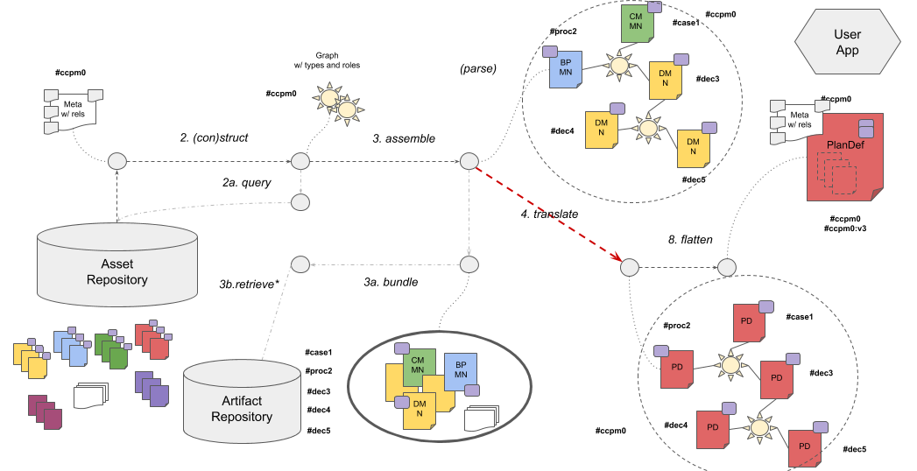
Example / Composites

Slide 41
Example / Composites
KnowledgeCarrier<FHIR> composite =
constructor.getKnowledgeBaseStructure(rootAssetId, Imports)
.flatMap(kc -> assembler.assembleCompositeArtifact(kc))
.flatMap(kc -> parser.applyLift(kc, Abstract_Knowledge_Expression))
.flatMap(ckc ->
translator.applyTransrepresent(
ckc,
rep(FHIR_STU3, SNOMED_CT)));
KnowledgeCarrier<FHIR> flat =
flattener.flattenArtifact(composite, rootAssetId);
Complex operations decomposed into well-defined, functional steps

Slide 42
Example / Query
KnowledgeCarrier<JenaSPARQLQuery> query = /* parse SPARQL using Jena */
KnowledgeCarrier<OntologyModel> ontology = /* parse OWL using Jena */
Bindings input = new Bindings<>(); // set input query variables
KnowledgeBaseApi kb = KnowledgeBaseAPI.newInstance( /* server */);
_askQuery q = ReasoningAPI._askQuery(/* server */).with(kb);
query = kb.initKnowledgeBase(query)
.flatMap(ptr -> kb.applyBind(ptr.uuid, ptr.versionTag, input);
Pointer oPtr = kb.initKnowledgeBase(ontology);
Bindings output = q.askQuery(oPtr.uuid, oPtr.versionTag, query);
Queries are treated as Knowledge Assets

Slide 43
Example / GraphQL +SPARQL
GQL Schema
type Query { hello: String }
2. askQuery
0. publish
1. populate
{ hello }
Qry
KB Manager
Asset Repository
GQL Query
3. askQuery
Qry
KB Manager
1. populate
0. publish
4. Bind
{ “hello” : “world” }
?hello <- “world”
0. publish
:x :h “world”
RDF Graph
SELECT ?hello {
:x :h ?hello }
SPARQL Query

Slide 44
Example / GraphQL
KnowledgeCarrier<String> gqlQuery =
of( “{ hello }” )
.withRepresentation(GQL, GQL_QRY, TXT, default()));
KnowledgeCarrier<String> gqlSchema =
of( “type Query { hello : String }” )
.withRepresentation(GQL, GQL_SCHEMA, TXT, default()));
KnowledgeCarrier<String> sparqlQuery =
of( “SELECT ?hello { BIND(‘world’ as ?hello) }” )
.withRepresentation(SPARQL, TXT, default()));
{ gqlQuery, gqlSchema, sparqlQuery }.forEach( x ->
assetRepo.setKnowledgeAssetCarrierVersion(
x.assetId, x.versionTag,
x.artifactId, x.artifactVersionTag,
x.asBinary())

Slide 45
Example / GraphQL
KnowledgeBaseApi kbManager =
KnowledgeBaseApi.newInstance(new KBManager(assetRepository));
_askQuery engine =
new GraphQLEngine(kbManager, assetRepository) {
...
assetRepository.getKnowledgeAsset(sparqlQuery.uuid);
...
}
Pointer gqlPtr = kbManager.initKnowledgeBase(gqlSchema);
Bindings response =
gqlQuery.flatMap( query ->
gqlPtr.flatMap( ptr ->
engine.askQuery(
ptr.uuid, ptr.versionTag, query )))
KP components are implemented either (1) adapting existing OOB components to implement the APIs
or (2) implementing the APIs natively or (3) via recursive orchestration of API4KP operations

Slide 46
Next Steps
Move into Finalization Phase
Refine the Documentation
Consolidate the various PIM/PSM alignments
Focus on Usability
Publish More Examples

Slide 47
Implementation Use Cases
Mayo Clinic “KMDP API Portfolio”
Care Process Models (BPM+ 4 Health, FHIR)
Process / Ontology / Terminology / Patient Data integration points
Individualized Content
Knowledge Asset Repository Facades
Wrap Mayo Clinic’s native:
Content Management System
BPM+ System Authoring / Repository
Electronic Health Record’s Clinical Decision Support Rule repository
Terminology Service
RDF + SPARQL
In collaboration with FraunHofer Institute
Cross-Standard Initiatives
OMG’s BPM+4Health vs HL7’s Clinical Practice Guideline on FHIR

Slide 48
Discussion
Exception / Explanation Handling
Most Operations return an (optional) Explanation secondary output
An Explanation is a Knowledge Resource itself, expressed in some KRR language
Usually provided natively by KP Components
Explanations are structured into complex Resources as Operations are chained
This capability is expected to be provided by the API layer
Provenance concepts can be leveraged by actual implementations (e.g. W3C Prov)

Slide 49
Discussion
Performance Impact
API overhead should be minimal
APIs expose, rationalizing and normalizing them, functionalities normally required to use knowledge bases and related platforms
APIs are compatible with implementations based on facades
API granularity may change to minimize the number of invocations required by common use cases, across use cases
Pilot implementation @Mayo Clinic
Web-Service oriented PSMs may be critical
(same as above)
APIs designed for chaining
Resources can be passed by Reference
Most operations are functional (→ caching) and suitable for lazy implementations

Slide 50
Discussion
Security
API specification is transparent to any security layer imposed around (i) access to Knowledge Resources and (ii) invocation of the APIs.
E.g. RESTful implementations are likely to use OAuth or other state of the art mechanisms
Caveats
Knowledge Resource Descriptions (aka “metadata”) carry licensing information, possibly expressed in a computable format
APIs can be used to abstract knowledge-based policy enforcement systems, or components thereof (e.g. access control rules implemented in a BRMS)

Slide 51
Discussion
Related Work
CTS-2
A terminology service is a special case of KP, working on KBs of a specific kind
A conceptual mapping of CTS-2 like* operations to particular configurations of API4KP operations will be provided as a corollary
DOL
API4KP is more general than DOL
DOL makes more specific assumptions about the nature of Knowledge Resources and Knowledge Bases.
API4KP reuses, generalizing them, many of the concepts and operations defined in DOL
DOL can provide API4KP services
DOL specifications describe complex KB, and are Knowledge Resources themselves
DOL specifications could be interpreted in terms of (chains of) API4KP operations
Implementations of DOL operations could be exposed through API4KP

Slide 52
Discussion
Changes to ODM
No need to change the ODM has arisen
Standard URIs to denote logics, languages and formats for knowledge representation – and versions thereof - are needed
The role of ‘model’ MIME types is being investigated

Slide 53
Important Dates
TODO

